Slide 1


Slide 2
DEPARTMENT OF MICROBIOLOGY
VIROLOGY LABORATORY

Slide 3
INVESTIGATIONS DONE
ELISA for :
Hepatitis B surface Ag (HBsAg)
Hepatitis C Virus (HCV)
Hepatitis A Virus (HAV)
Hepatitis E Virus (HEV)
Human Immunodeficiency Virus (HIV)
Dengue
TORCH (Toxoplasmosis, Rubella, Cytomegalovirus & Herpes)
Japanese Encephalitis
Chikungunya
Anti Hepatitis B surface Ab(Anti HBsAb)

Slide 4
Rapid Test:
Dengue NS1 Ag, IgM, IgG
HBsAg
HCV
HIV
Chikungunya
CD4 count

Slide 5
Introduction of Newer Diagnostic test
Real Time Micro PCR –a chip based PCR technology for H1N1 testing.

Slide 6
Future prospective:
Viral load--Testing for Hepatitis B viral load (HBV-DNA)

Slide 7
HIV INVESTIGATIONS

Slide 8
HIV INVESTIGATIONS

Slide 9
HEPATITIS B INVESTIGATIONS

Slide 10
HEPATITIS B INVESTIGATIONS

Slide 11
HCV INVESTIGATIONS

Slide 12
HCV INVESTIGATIONS

Slide 13
DENGUE INVESTIGATIONS

Slide 14
EQUIPMENTS
ELISA Reader Dispenser & Washer.
ELISA washer
Deep freezer
Pima CD4 counter
Refrigerator
Incubator
Autopipettes
True Lab Uno Dx Real Time Quantitative micro PCR Analyzer

Slide 15
PROJECTS
Completed
Spectrum of blood borne viral hepatitis with special reference to HCV genotyping.

Slide 16
PROJECTS
Completed Research Project:
Seroprevalence of Antibodies to Hepatitis C Virus in a Hospital Based Population – A Study from Western Maharashtra
Seroprevalence of Hepatitis B Antigen in a Teaching Hospital of Western Maharashtra.
Trend of Seroprevalence of HIV, HBsAg & HIV Antibodies among Pregnant Mothers Attending a Rural Teaching Hospital.
Risk of Co-Existence of HIV, HBV and HCV Infection among Pregnant Women From Karad.
Socio-demographic Profile of Seropositive HBsAg Patients Attending Tertiary Care Hospital of Rural Maharashtra.

Slide 17
PUBLICATIONS
Patil SR, Ghorpade MV, Patil SS, Pawar SK, Mohite ST. Seroprevalence of Hepatitis-B surface antigen among the patients reporting at tertiary care Hospital from India. Bangladesh Journal of Medical Science. 2016 Nov 3;15(3):455-9.
Patil SR, Patil SS, Shinde RV, Karande GS, Patil HV, Mane PM. Seropositivity and Risk Factors of Hepatitis B in Maharashtra, India. JOURNAL OF KRISHNA INSTITUTE OF MEDICAL SCIENCES UNIVERSITY. 2016 Jan 1;5(1):82-90.
Patil SR, Ghorpade M V , Patil SS, Shinde R V., Mohite S T. Seroprevalence of Antibodies to the Hepatitis C virus in a Hospital–Based Population: A study from western Maharashtra, India . International Journal of Collaborative Research on Internal Medicine & Public Health 2014 ; 6 (4):102-108
Patil SS, Patil SR, Durgawale PM, Patil AG. A study of the outbreak of Chikungunya fever. Journal of clinical and diagnostic research: JCDR. 2013 Jun;7(6):1059.

Slide 18
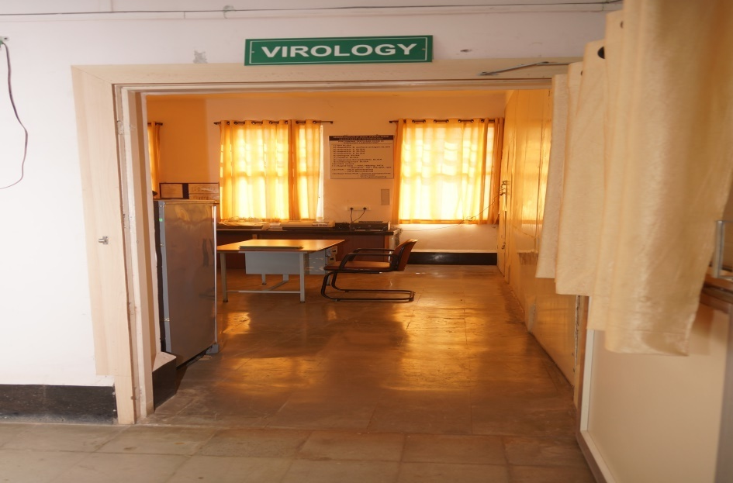
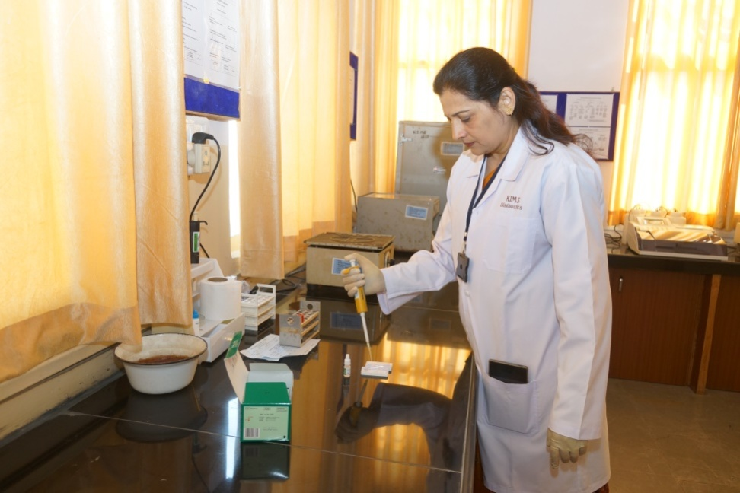
VIROLOGY LABORATORY
• ELISA :
Hepatitis B surface Ag (HBsAg)
Hepatitis C Virus (HCV)
Hepatitis A Virus (HAV)
Hepatitis E Virus (HEV)
Anti Hepatitis B surface Ab(Anti HBsAb)
Human Immunodeficiency Virus (HIV)
Dengue
TORCH
Chikungunya
Japanese Encephalitis
• Immunochromatography :
Dengue, HBsAg, HCV, HIV, Chikungunya.
CD4 count

Slide 19
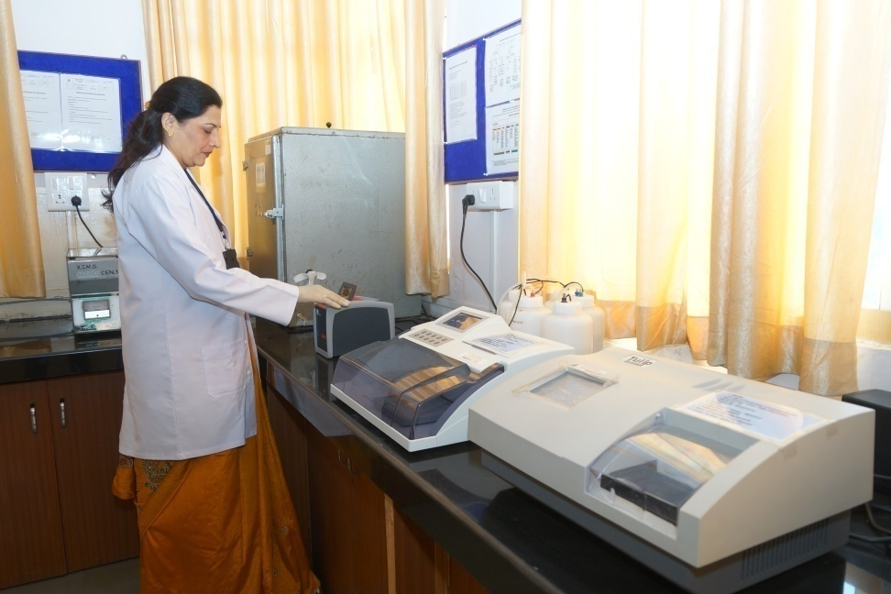
Virology laboratory (contd)
Real time PCR – future prospectives.
- Viral load
- Viral genotyping

Slide 20
KIMS DIAGNOSTICS
MICROBIOLOGY SECTION
Parameters accreditated – by NABL
HBsAg ELISA – for Antigen detection
HCV ELISA - for Antibody detection
HIV ELISA - for Antibody detection
Rapid test for HIV – a) Tridot
b) Retroquic
External Quality Assessment Scheme (EQAS) by
Virology EQAS, Christian Medical college, Vellore, Tamilnadu

Slide 21
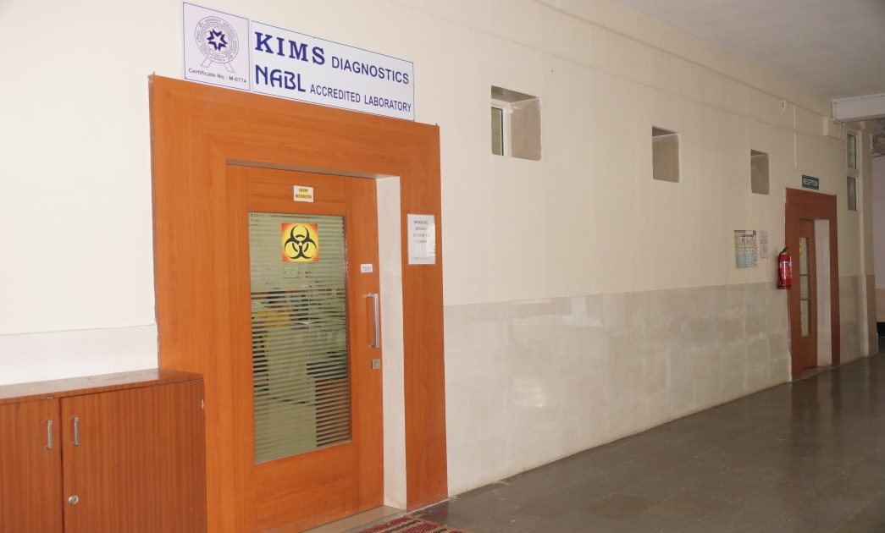
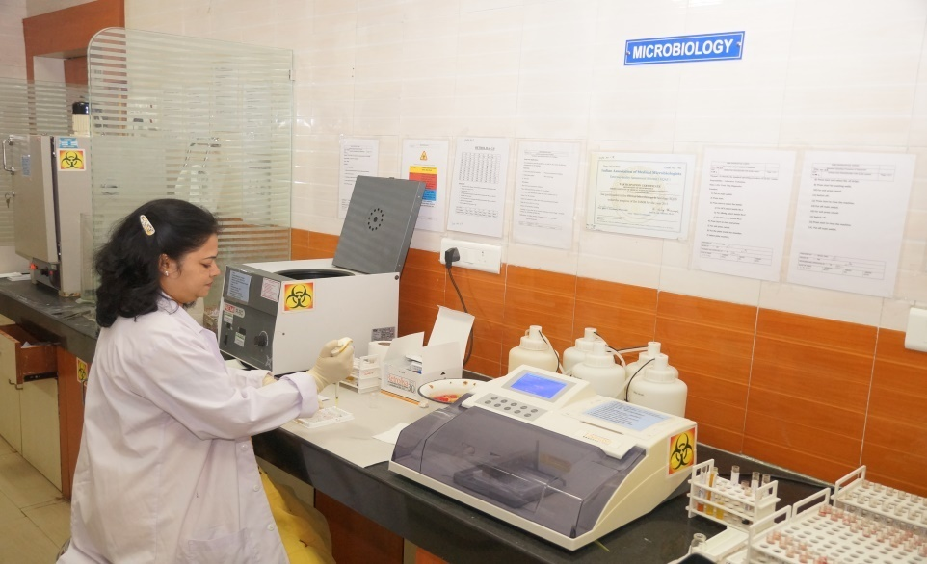
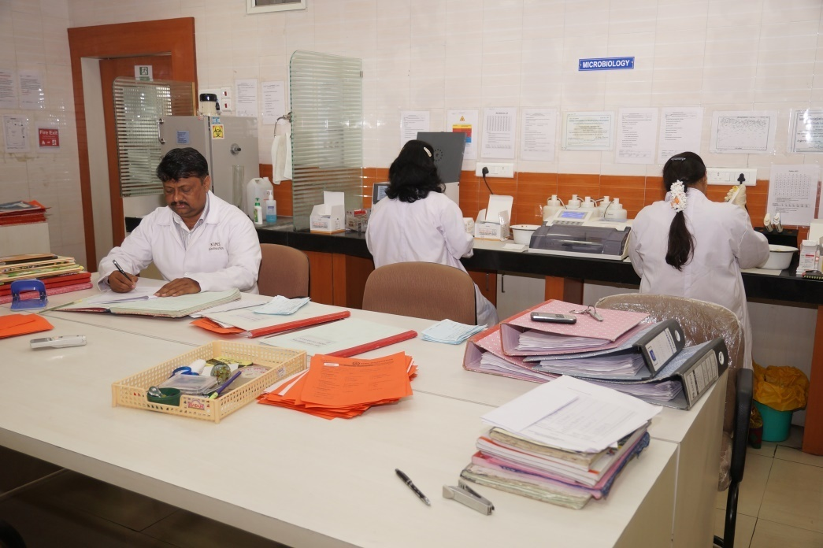
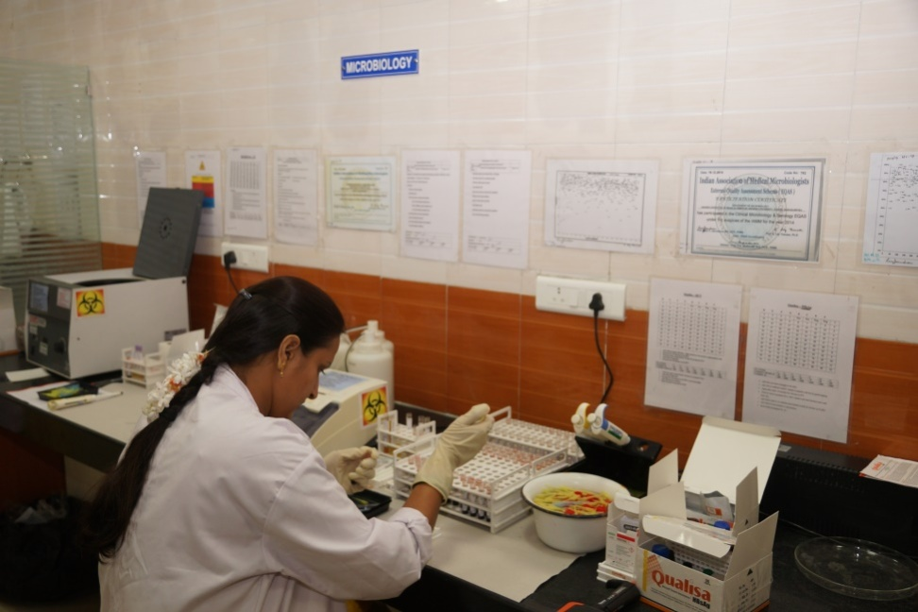
KIMS Diagnostics

Slide 22
THANK YOU

