Slide 1
DEPARTMENT OF MOLECULAR BIOLOGY AND GENETICS
VISION:
To develop the department as a beacon of cutting edge translational research with conducive environment for researchers from various disciplines.
MISSION:
A step towards personalized medicine by facilitating research in Molecular Biology and Genetics.
Help to improve the quality of diagnosis with use of molecular diagnostic tools.

Slide 2
PREAMBLE
The Department of Molecular Biology and Genetics is certified as Centre of Excellence and is an in house facilities for
(a) Molecular Diagnostics:
Infrastructure for Molecular testing, karyotyping, immunohistochemistry, and mutational analysis
Molecular Testing:
Molecular testing involves DNA testing of human papilloma virus and real time PCR based test for qualitative detection of influenza (H1N1) virus, and SARS CoV-2 (Covid-19) virus.
Genetic disorders: Duchene muscular Disorder (DMD), Thalassemia
Viral markers: HPV, HCV
Influenza (H1N1) Testing
SARS-Cov2 Virus testing
Karyotyping:
detailed analysis chromosomes to detect abnormalities of the number or structure of chromosomes for prenatal and post natal diagnosis of genetic disorders. Numerical and structural chromosome abnormalities like trisomy, deletions and translocations of chromosomes are diagnosed.
Immunohistochemistry:
Immunohistochemistry is a special staining process performed on fresh or frozen breast cancer tissue removed during tumor biopsy for identification of prognostic markers for decision making of treatment. IHC is used to show whether or not the cancer cells have hormone receptors and/or hormone receptors on their surface (ER,PR, Her2/Neu). This information plays a critical role in treatment planning. There is a scope for further expansion of Immunohistochemistry technique for identification of other cancer markers including EGFR, CK-19, Ki-67, PCNA, PTEN.
Mutational Analysis:
There is also a great scope to study mutational analysis in different oncogenes and gene expression profiling of the breast cancer patients to study overall pattern of genomics and transcriptomics in the South-western Maharashtra state of India. This could help to find prevalence and heterogeneity of mutations in different genes including BRCA1, BRCA2, BRAF, KRAS, PI3KCam P53, AKT in breast cancer. Also there is a scope for integrative genomic and proteomic analysis of BRCA1, BRCA2, BRAF, KRAS, PI3KCam P53, AKT in breast cancer. Gene mutation studies in breast cancer is one of the research areas where genetic mutations in genes of different pathways will also be studied

Slide 3
(b) Krishna Breast cancer Tissue Bank (KBTB):
In- house specimen tissue bank of breast cancer cases originating from Krishna Hospital as a source of tissue material for research.
Krishna breast tumor bank (KBTB) established at Krishna Institute of Medical Sciences University on 15th September 2013 the breast tissue samples from more than 200 breast cancer patients including (Tumor tissue, adjacent tissue, lymph nodes) were cryopreserved. The hormone receptor status of these patients were also confirmed by immunohistoshemistry by using antibodies against estrogen receptor(ER), progesterone receptor (PR) and Human epidermal growth factor receptor (HER2).
(c) Animal Tissue Culture Laboratory :
Cell culture facility for research with primary cell culture and established cell lines. The animal cell culture has a scope for a diverse range of research and development including a) Cancer research which requires the study of uncontrolled cell division in cultures. b) Genetic manipulation, which is easy to carry out in cells or organ cultures. c) Production of pharmaceutical drugs using cell lines.
(d) Thrust Areas for Molecular Research:
This centre of excellence will open up new platform for researchers to come up with novel ideas in translational research at molecular level and strengthen the support to researchers not only in house but outsider also. This centre will promote the researchers in the field of: 1. Proteomics, Transcriptomics and Genomics approach for Identification of potential biomarkers of cancer
2. Pharmacogenomics and pharmacoproteomics (Anticancer properties of phytochemicals form medicinal plants)
3. Biogenic synthesis of nanoparticles and characterization of thein biological potentials including antioxidant, antimicrobial, antiparasitic and anticancer activities.

Slide 4
Infrastructure:
Molecular & Genetic Laboraoory was started at Krishna Institute of Medical Sciences University, Karad in year 2011 with preliminary laboratory setup. Thereafter the laboratory was renamed as Department of Molecular Biology & Genetics and was recognized as Centre of Excellence on 27th October 2017. Department of Molecular Biology & Genetics is engaged in PCR based molecular diagnosis of genetic disorders including Duchene Muscular Dystrophy (DMD) and beta-thalassemia. The Department is also involved in molecular testing and genotyping of viral markers like Human Papilloma Virus (HPV) from cervical patients and also testing of Hepatitis C virus (HCV) with the help of polymerase chain reaction. Department of Molecular Biology has established advanced Breast tumor bank (KBTB) for cryopreservation the tumor tissue. Immunohistochemistry is a special staining process is used in diagnosis of the status of prognostic markers such as hormone receptors from breast cancer patients including, Estrogen Receptor (ER), Progesterone receptor (PR), Human epidermal growth factor receptor 2 (HER2). Karyotyping is a detailed analysis of chromosomes to detect abnormalities of chromosomes obtained from peripheral blood samples and staining by Geimsa staining and mapping with the Carl Zeiss/Metasystems Axiscope-1 karyotyping workstation is established. Numerical and structural chromosome abnormalities like trisomy, deletions and translocations of chromosomes are diagnosed in the laboratory. Department of Molecular Biology and Genetics is now accreditated with National Accreditation Board for Testing and Calibration Laboratories (NABL) with Certificate no. MC-3214 effective from 25th July 2019. The HPV DNA testing and Influenza testing are the molecular tests and karyotyping as cytogenetic test are recognized under the scope of NABL.
Molecular research on exploration of molecular mechanisms of cancer chemotherapeutics to study the role of novel phytochemicals derived from endangered medicinal plants of Western Ghats of Maharashtra in chemoprevention of cancer and biogenic synthesis and molecular characterization of the effects of biogenic nanoparticles synthesized from endangered medicinal plants. Also studies on genetic polymorphisms in carcinogen detoxifying genes, DNA repair genes, oxidative stress related genes, tumor suppressor genes, alcohol detoxifying genes and metabolic genes and risk of breast cancer, head and neck cancer, cervical cancer and gastrointestinal cancer in rural population are in progress to study single nucleotide polymorphisms and their association with cancer development.
Also, the studies are being carried out on genetic polymorphisms in different cancer related genes including DNA repair genes, Oxidative stress related genes, Carcinogen detoxifying genes with respect to Breast, Cervical and Oral cancer. Our aim was also to establish advanced Breast tumor bank where we are trying to cryopreserve the breast tumor tissue and normal tissue for breast cancer research. One of our goals was to establish cell culture facility for cells derived from breast tumor tissue and normal tissue from breast cancer patients. Now we have infrastructure for genetic disorder studies as well as molecular cancer research. We have advanced equipments for research and diagnosis including, Mastercycler PCR Machine (Make-Eppendorff) (Two),Gel documentation system (Make- BioRad), Real time PCR (Biorad) Automated RNA extractor (Thermo Scientific) Upright Fluorescence Microscope with Karyotyping and FISH facility make (Carl Zeiss), Two -80⁰C deep freezers (Make-Eppendorff), one -20⁰C freezer and Two 4⁰C refrigerators (Make-Godrej), One Co2 incubator (Thero Scientific), Two biosafety cabinets (MicroFilt), Laminar Air Flow, PCR workstation, Weighing balance, pH meter, Two high speed cooling centrifuges (Make-Eppendorff, PlastoCraft), normal centrifuges, Vortex machine, micropipettes, Water bath, Oven, Incubator.
We have also submitted research proposals to different funding agencies like, ICMR, DBT, DST, and SERB for research grants. Now, Molecular & Genetics laboratory is renamed as Department of Molecular Biology and Genetics which certified as centre of excellence.

Slide 5
Faculty
Sr. No. | Name | Qualification | Designation
1 | Dr. Kailas D. Datkhile | M.Sc. Ph.D Biotechnology | Incharge, Senior Research Officer
2 | Ms. Madhavi N. Patil | M.Sc. Biochemistry | Junior Research Officer
3 | Mr. Pratik P. Durgavale | M.Sc. Biotechnology | Research Officer
4 | Mr. Dilip D. Hinge | M.Sc. Microbiology | Research Officer
5 | Ms. Nilam J. Jagdale | M.Sc Biotecnology | Junior Research Assistant
6 | Mr. Vinit N. Deshmukh | M.Sc Biotecnology | Junior Research Assistant
7 | Mrs. Ashwini L. More | PG, DMLT | Technician
8 | Mr. Santosh H. Jadhav | SSC | Attendent
Responsibilities:
The In charge of Department of Molecular Biology and Genetics is responsible for overall management of Laboratory.
Junior Research Officers and Research Assistants are responsible for:
Research and development/standardization of protocols
Maintenance of appropriate records
Calibration of measuring/monitoring equipments used

Slide 6
Molecular and Genetic Research Advisory Committee (MGRAC)
List of Committee Members
Sr. No. | Name | Designation | Area(s) of expertise | Qualification(s) | Affiliation(s)
 | Dr Arun R. Risbud | Chairman | Preventive and Social Medicine (PSM) | MBBS,MD | Krishna Institute of Medical Sciences, Deemed University, Karad
 | Dr. Anita Kar | Research Advisor | Human Genetics | M.Sc Ph.D | School of Health Sciences, Pune University Pune
 | Dr. Mohan R. Wani | Member | Stem cell Science and Regenerative Medicine | M.V. Sc. Ph.D. (Medicine) University of London, England | National Centre for Cell Science, Pune
 | Dr. A. V. Sontakke | Member | Biochemistry | MBBS, MD | HOD, Department of Biochemistry, KIMSDU, Karad
 | Dr. Sujata Kanetkar | Member | Pathology | MBBS, MD | HOD, Department of Pathology, KIMSDU, Karad
 | Dr. G. S. Karande | Member | Microbiology | MBBS, MD | HOD, Department of Microbiology, KIMSDU, Karad
 | Dr. Kailas D. Datkhile | Member Secretary | Cell & Molecular Biology, Nanotechnology | M.Sc. Ph.D (Biotechnology) | Incharge, Department of Molecular Biology & Genetics, KIMSDU, Karad

Slide 7
Agenda of MGRAC
The review of the ongoing research activities and research projects in the Department of Molecular Biology & Genetics.
Discussions regarding the future research plans of the Department of Molecular Biology and Genetics.
To review the scope of molecular diagnostics of various disorders and diseases
Minutes of recent MGRAC meeting
The meeting of Molecular & Genetic Research Advisory committee was held on 8th September 2020 at11.00 a.m. on virtual platform. The following members attended the meeting
Dr. Arun R. Risbud, Krishna Institute of Medical Sciences, Deemed University, Karad
Dr. Anita Kar , School of Health Sciences, Pune University, Pune
Dr. Mohan R. Wani, National Centre for Cell Science, Pune
Dr. A. V. Sontakke, HOD, Department of Biochemistry, KIMSDU, Karad
Dr. Sujata Kanetkar , HOD, Department of Pathology, KIMSDU, Karad
Dr. G. S. Karande, HOD, Department of Microbiology, KIMSDU, Karad
Dr. Kailas D Datkhile , Incharge, Molecular & Genetic Laboratory, KIMSDU, Karad
Resolution
1. The detailed review of the ongoing research activities in the in Department of Molecular Biology & Genetics was carried out
2. The detailed review of the molecular diagnostics and desktop surveillance for NABL accreditation after completion of one year in the Department of Molecular Biology & Genetics
3. Future plans for the molecular research of Department of Molecular Biology and Genetics were discussed.
4. It was also decided to initiate new research projects in the field of Nanotechnology and Covid-19.
5 Detailed discussions on assessment of Department of Molecular Biology and Genetics on 25th April 2020 by NABL Assessment team for Scope extension, Influenza (H1N1) virus testing by real time PCR and the laboratory of the Department was accreditated by NABL. Also the plans and the currecnt status of SARS-CoV2 (COVID-19) virus testing was detailed to the expert panel.

Slide 8
List of Ongoing Research Projects:
Studies on genetic polymorphisms in carcinogen detoxifying genes, DNA repair genes, oxidative stress related genes, tumor suppressor genes, alcohol detoxifying genes and metabolic genes and risk of oral cancer in rural population. A case- control study from Maharashtra.
Studies on genetic polymorphisms in carcinogen detoxifying genes, DNA repair genes, oxidative stress related genes, tumor suppressor genes & metabolic genes and risk of cervical cancer in women from rural population. A case- control study from Maharashtra.
Studies on genetic polymorphisms in carcinogen detoxifying genes, DNA repair genes, oxidative stress related genes, tumor suppressor genes, alcohol detoxifying genes and metabolic genes and risk of breast cancer in rural population. A case- control study from Maharashtra.
Studies on Identification, Molecular, Biochemical and Biophysical Characterization of Eukaryotic Initiation Factor 2α (eIF2α) Kinase and its substrate from Indian tropical midge Chironomus ramosus: Overexpression and Structural studies
Biosynthesis and molecular characterization of the biological effects of biogenic nanoparticles synthesized using endangered medicinal plants.
Exploration of molecular mechanisms of cancer chemotherapeutics: To study the role of novel phytochemicals derived from endangered medicinal plants endemic to Western Ghat of Maharashtra in chemoprevention and chemoprotection of cancer.
Study of SARS-CoV2 virus positivity rate among patients attending Krishna Hospital & Medical Research Center- ‘A Dedicated COVID Hospital’.

Slide 9
Kailas D. Datkhile, Pallavi S. Gaikwad, Saroj S. Ghaskadbi, Rita Mukhopadhyaya & Bimalendu B. Nath. 2015. Chironomus ramosus larvae exhibit DNA damage control in response to gamma radiation. International Journal of Radiation Biology.91 (9) 742-748.(Indexed in : Pubmed, Scopus, Thomson Reuters)
Kailas D. Datkhile, Kshamata V. Thorat, Madhavi N. Patil, Rohit D. Vhaval,Varadrajulu G. Mandiri (2015). The Spectrum of Dystrophin Gene Mutations in Duchene Muscular Dystrophy Patients of South-Western Maharashtra in India. JKIMSU, Vol. 4, No. 2, 70-80. (Indexed in: Scopus, Thomson Reuters, Index Copernicus
Kailas D. Datkhile , Madhavi N. Patil , Rohit D. Vavhal , Tejasvi S. Khamkar (2015). The Spectrum of b-Globin Gene Mutations in Thalassemia Patients of South-Western Maharashtra: A Cross Sectional Study. JKIMSU, Vol. 4, No. 3, 49-58. (Indexed in: Scopus, Thomson Reuters, Index Copernicus)
Pratik Durgawale, Rohan Phatak, Kailas Datkhile, Anup Hendre, Pushpa Durgawale. 2015. Biologically Synthesized Silver Nanoparticles from Latex of Syandenium grantii and Fresh Leaves of Kalanchoe pinnata: Potential Source of Cytotoxic Agents against Cervical Cancer Cells. International Journal of Science & Research. 4: 10; 340-343. (Indexed in: Index Copernicus)
Kailas D. Datkhile, Rohit D. Vhaval, Madhavi N. Patil, Tejasvi S. Khamkar, Pratik P. Durgavale, Anand Gudur, Nupura Vibhute, Ritwij Patankar, Nevilli Tata, P. G. Chougule , Satish V. Kakade. 2016. Role of genetic polymorphisms in DNA repair genes (XRCC1, XRCC2, XRCC3, XRCC4, XRCC5, XRCC6, XRCC7) in head and neck cancer susceptibility in rural Indian population: A hospital based case-control study from south- western Maharashtra. International Journal of Current Research, 8: 1; 25482-25492. (Indexed in: Index Copernicus)
Kailas D. Datkhile, Pratik P.Durgavale, Madhavi N. Patil, Rohit D. Vhaval,Tejasvi S. Khamkar .2016. Evaluation of in vitro Antioxidant and Free Radical Scavenging Properties of Different Parts of Medicinal Plant Nothapodytes foetida (Family: Icacinaceaae). International Journal of Scientific Research, 5: 5; 80-84. (Indexed in: Index Copernicus)
Kailas D. Datkhile, Rohit D.Vhaval, Madhavi N. Patil, Tejasvi S. Khamkar, Pratik P. Durgawale, P. G. Chougule, Neville Tata, Ritwij Patankar, Anand Gudur, Satish V. Kakade .2016. Identification of genetic polymorphisms in DNA repair xenoderma pigmentosum group D (XPD) gene and its association with head and neck cancer susceptibility in rural Indian population: A hospital based case-control study from south-western Maharashtra. International Journal of Research in Medical Sciences, 4: 6; 1997-2005. (Indexed in: Index Copernicus, Index Medicus, Scopemed)
Durgawale Pratik Prakash, Datkhile Kailas Dhondibhau. 2016. Study of In-vitro Anti-Cancer and Anti-Oxidative Properties of Aqueous Extract of Punica Granatum Flowers. International Journal of Pharmaceutical Science Review & Resaearch, 38:1; 271-275. (Indexed in: Scopus, Index Copernicus)
Durgawale Pratik Prakash, Datkhile Kailas Dhondibhau. 2016. Study of In vitro anticancer and antioxidative properties of methanolic extracts of Punica granatum flowers. Der Pharmacia Lettre, 8:11;197-201. (Indexed in: Scopus, Index Copernicus)
Rohit D. Vhaval, Kailas D. Datkhile, Madhavi N. Patil, Tejasvi S. Khamkar, Pratik P. Durgawale, Satish V. Kakade. 2016. Association between genetic polymorphisms of DNA repair genes (xpc, xpg) and head and neck cancer susceptibility in Indian population: a hospital based case-control study. European journal of pharmaceutical and medical research. 3 (10) 408-415. (Indexed in: Index Copernicus, DOAJ)
List of Publications (2015-2020)

Slide 10
11. Madhavi N. Patil, Kailas D. Datkhile, Suresh J. Bhosale, Pandurang G. Chougule, Rohit D.Vhaval, Tejasvi S. Khamkar, Pratik P. Durgawale, Satish V. Kakade. 2016. Role of genetic polymorphisms in XRCC4, XRCC5, XRCC6 and XRCC7 in breast cancer susceptibility in rural Indian population: A hospital based case-control study from Maharashtra. International Journal of Health Sciences Research.6(11)24-32. (Indexed in: Index Copernicus, Scopemed, DOAJ)
12. Kailas D. Datkhile, Madhavi N. Patil, Tejasvi S. Khamkar, Rohit D. Vhaval, Pratik P Durgawale, Pandurang G. Chougule, Anand Gudur Satish V. Kakade .2017. Genetic polymorphisms in DNA repair genes (hOGG1 & APE1) and their association with oral cancer susceptibility in rural Indian population: A hospital based case-control study. International Journal of Medical Science & Physical Health : 6 (1) 23-28. (Indexed in: Index Copernicus, Index Medicus)
13. Kailas D. Datkhile, Suresh J. Bhosale, Madhavi N. PatilTejasvi S. Khamkar, Pratik P. Durgawale, Satish V. Kakade. 2017. Genetic Polymorphism of DNA Repair Genes (XRCC1, XRCC2 & XRCC3) in Breast Cancer Patients from Rural Maharashtra. International Journal of Health Sciences Research.7 (2)281-290. (Indexed in: Index Copernicus, Index Medicus)
14. Kailas D. Datkhile, Pratik P. Durgawale and Madhavi N. Patil. 2017. Biogenic silver nanoparticles are equally cytotoxic as chemically synthesized silver nanoparticles. Biomedical and Pharmacology Journal. 10 (1) 337-344. (Indexed in: Scopus, Thomson Reuters, Index Copernicus)
15. Datkhile KD, Bhosale SJ, Patil MN, Durgawale PP, Kakade SV. 2017. Genetic polymorphisms of DNA repair genes (XPC, XPG) and breast cancer susceptibility in Maharashtrian population: A hospital based case-control study. International Journal of Current Advanced Research. 6 (5) 3826-3831. (Indexed in: Scopus, Thomson Reuters, Index Copernicus)
16. Durgawale PP & Datkhile KD. 2017. Study of Polyphenol Content and Anti- Oxidative Potential of Tribulus terrestris Dry Fruit Extract. International Journal of Pharmacognosy and Phytochemical Research. 9(5); 716-721. (Indexed in: Scopus)
17. Kailas D. Datkhile, Pratik P. Durgawale and Madhavi N. Patil. 2017. Biogenic silver nanoparticles from Nothapodytes foetida kills human cancer cells in vitro through inhibition of cell proliferation and induction of apoptosis. Journal of Bionanoscience 11, 416 - 427. (Indexed in: Scopus, Chemical Abstract Services, Thomson Reuters)
18. Datkhile KD, Bhosale SJ, Patil MN, Durgawale PP, Kakade SV. 2017. Genetic polymorphisms of DNA repair gene (XPD) and breast cancer risk in a hospital based case-control study from maharashtra. International Journal of Health Sciences & Research. 7 (7) 290-298. (Indexed in: Index Copernicus, Index Medicus)
19. Kailas D. Datkhile, Suresh J. Bhosale, Madhavi N. Patil, Pratik P. Durgawale and Satish V. Kakade. 2017. Association of Genetic Variants in hOGG1 and APE1 Genes with Breast Cancer Risk in a Rural Population: a Hospital Based Case-Control Study. JKIMSDU.6 (4) 18-27. (Indexed in: Scopus, Thomson Reuters Index Copernicus)
20. Pratik P. Durgawale, Kailas D. Datkhile, Satish V. Kakade. 2018. Cytoprotective Activity of Tribublus terrestris Dry Fruit Extract against Oxidative Stress. Der Pharma Chemica. 10 (3) 29-34. (Indexed in: Scopus)

Slide 11
21. Kailas D. Datkhile, Pratik P. Durgawale Madhavi N. Patil. 2018. In Vitro Evaluation of Cytotoxic and Genotoxic Effects of Plant Extracts From Nothaphodytes foetida (Wight) Sleumer (Family: Icacinaceae) on Cancer Cells. Asian Journal of Pharmaceutical and Clinical Research. 11 (12) 284-291. (Indexed in: Index Copernicus, Scopus)
22. Datkhile KD, Patil MN, Durgawale PP, Korabu KS, Joshi SA, Kakade SV. Association of genetic polymorphisms in XRCC4, XRCC5, XRCC6 and XRCC7 in cervical cancer susceptibility from rural population: a hospital based case-control study. International Journal of Research in Medical Sciences. 2018; 6:2453-2459. (Indexed in: Index Copernicus)
23. Kailas D. Datkhile, Madhavi N. Patil, Pratik P. Durgawale, Shreepad A. Joshi, Kalpita S. Korbu, Satish V. Kakade. 2018. Assessment of role of genetic polymorphisms in XRCC1, XRCC2 and XRCC3 in cervical cancer susceptibility from a rural population: A hospital based case-control study from Maharashtra. International Journal of Research in Medical Sciences. 2018; 6 (9)3132-3139. (Indexed in: Index Copernicus).
24. Shreepad A. Joshi, Kailas D. Datkhile*, Madhavi N. Patil, Pratik P. Durgawale, Kalpita S. Korabu and Satish V. Kakade. Polymorphisms in ape1 and hogg1 DNArepair genes and risk of cervical cancer in Maharashtrian women: a hospital based case-control study. European Journal of Pgarmaceutical and Medical Research 2018, 5(10), 258-264. (Indexed in: Index Copernicus).
25. Madhavi N. Patil, Kailas D. Datkhile, Pratik P. Durgawale, Nitin S. Kshirsagar, Sujata S. Kanetkar, Satish V. Kakade. Association of Genetic Variants in XPC and XPG Genes with Cervical Cancer Risk in a Rural Population: A Hospital Based Case Control Study. JKIMSU. 2018, 7 (4), 54-64. (Indexed in: Scopus, Index Copernicus).
26. Korabu KS, Datkhile KD, Patil MN, Durgawale PP, Joshi SA, Kakade SV. Association of polymorphisms of xeroderma pigmentosum complementation group D with cervical cancer in Maharashtrian population: A case–control study. Int J Med Sci Public Health 2019; 8 (1). 46-52. (Indexed in: Index Copernicus).
27. Durgawale PP, Patil MN, Joshi SA, Korabu KS, Datkhile KD. Studies on phytoconstituents, in vitro antioxidant, antibacterial, antiparasitic, antimicrobial, and anticancer potential of medicinal plant Lasiosiphon eriocephalus decne (Family: Thymelaeaceae). J Nat Sc Biol Med 2019; 10:38-47. (Indexed in: Pubmed, Scopus).
28. Kailas D. Datkhile, Madhavi N. Patil, Pratik P. Durgawale, Kalpita S. Korabu, Shreepad A. Joshi, Anand Gudur, Rashmi A. Gudur, Satish V. Kakade. Genetic polymorphisms in carcinogen detoxifying genes and risk of cervical cancer in Maharashtra, India: a case control study. International Journal of biomedical Research. 2019. 10(4).e5105. DOI: https://doi.org/10.7439/ijbr (Indexed in: Index Copernicus, Pubget, NLM Catalog (NCBI), Crossref, EBESCO, JSTOR).
29. Datkhile Kailas D, Patil Madhavi N, Durgawale Pratik P, Gudur Anand, Gudur Rashmi A. Role of p53 and p21 Polymorphisms in Cervical Cancer Risk among Rural Population of South-Western Maharashtra: A Case-Control Study. Indian Journal of Public Health Research & Development. 2019, 10 (10) 277-281. (Indexed in: Scopus)
30. Kailas D. Datkhile, Satish R. Patil, Pratik P Durgavale, Madhavi N. Patil, Nilam J. Jagdale and Vinit N. Deshmukh. Studies on Antioxidant and Antimicrobial Potential of Biogenic Silver Nanoparticles Synthesized Using Nothapodytes foetida Leaf Extract (Wight) Sleumer. Biomedical & Pharmacology Journal, 2020. 13 (1), 441-448. (Indexed in: Scopus, Thomson Reuters, Index Copernicus)

Slide 12
31. Madhavi N. Patil, KailasD. Datkhile, Anand Gudur, Rashmi A. Gudur, Satish S. Kakade, Sandeep S. Kadam. Polymorphism in XRCC1, XRCC2 and XRCC3 genes and risk of gastrointestinal cancer: A case control study from south-western Maharashtra. Indian Journal of Public Health Research & Development. 2020. 11 (3), 997-1001. (Indexed in: Scopus)
32. Kailas D. Datkhile, Anand Gudur, Rashmi A. Gudur, Madhavi N. Patil, Pratik P. Durgawale, Vinit N. Deshmukh, Nilam J. Jagdale. Polymorphism in Superoxide Dismutase, Catalase Genes and Their Role in Cervical Cancer Susceptibility among Rural Population of Maharashtra: Findings from A Hospital based Case Control Study. Indian Journal of Forensic Medicine & Toxicology, 2020, 14 (3), 367-371. (Indexed in: Scopus)
33. Kailas D. Datkhile, Satish R. Patil, Madhavi N. Patil, Pratik P. Durgawale, Nilam J. Jagdale, Vinit N. Deshmukh. Studies on phytoconstituents, in vitro antioxidant, antibacterial and cytotoxicity potential of Argemone mexicana Linn. (Family: Papaveraceae). Journal of Natural Sciences Biology and Medicine 2020; 11:198-205. (Indexed in: Scopus and Pubmed)
34. Kailas Dhondibhau Datkhile , Satish Ramchandra Patil, Pratik Prakash Durgawale, Madhavi Narayan Patil, Nilam Jagannath Jagdale, Vinit Nitin Deshmukh, Ashwini Laxman More . Biogenic Silver Nanoparticles Synthesized Using Mexican Poppy Plant Inhibits Cell Growth in Cancer Cells through Activation of Intrinsic Apoptosis Pathway. Nano Biomedicine and Engineering. 2020, 12(3): 241-252 (Indexed in: Scopus and Pubmed)
35 Kailas D. Datkhile, Pratik P. Durgawale, Madhavi N. Patil, Nilam J. Jagdale, Vinit N. Deshmukh. Biosynthesis, Characterization and Evaluation of Biological Properties of Biogenic Gold Nanoparticles Synthesized Using Nothapodytes foetida Leaf Extract. Nanoscience & Nanotechnology Asia. 2020; doi: 10.2174/2210681210666200225112002 (Indexed in: Scopus and Pubmed)

Slide 13
Revenue Generation from Molecular Diagnostics
Year | Karyotyping | HPV DNA Testing | Immunohistochemistry | Influenza Testing | SARS-CoV Testing
2015 | 16000.00 | 4000.00 | 163200.00
2016 | 14000.00 | 24800.00 | 139200.00
2017 | 11600.00 | 12400.00 | 72000.00
2018 | 37800.00 | 48600.00 | 219000.00
2019 | 60000.00 | 27000.00 | 285000.00
2020 | 16000.00 | 24000.00 | 126000.00 | 105500.00 | 24081502.00

Slide 14
NABL Accreditation of Department of Molecular Biology & Genetics

Slide 17
Approval for Initiation of SARS-CoV-2 Virus testing

Slide 18
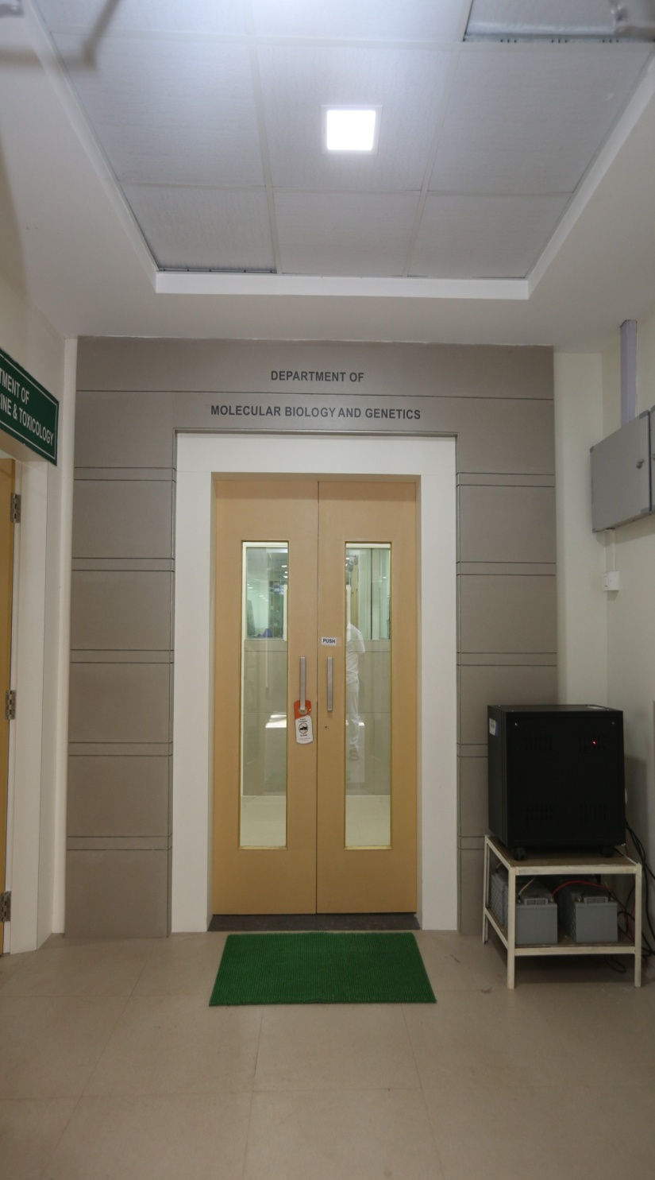
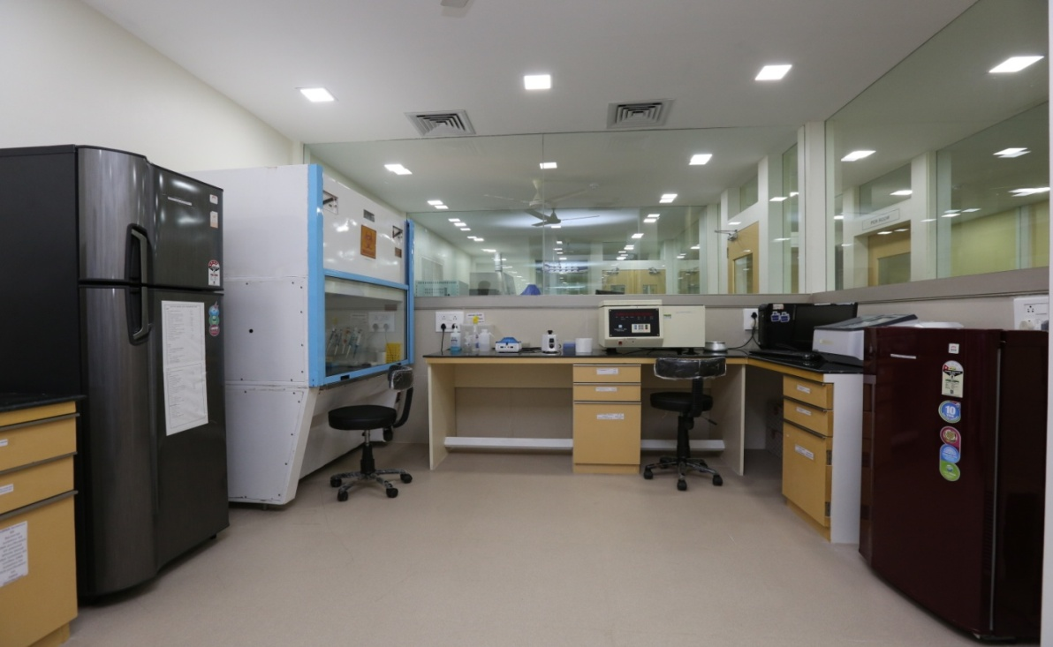
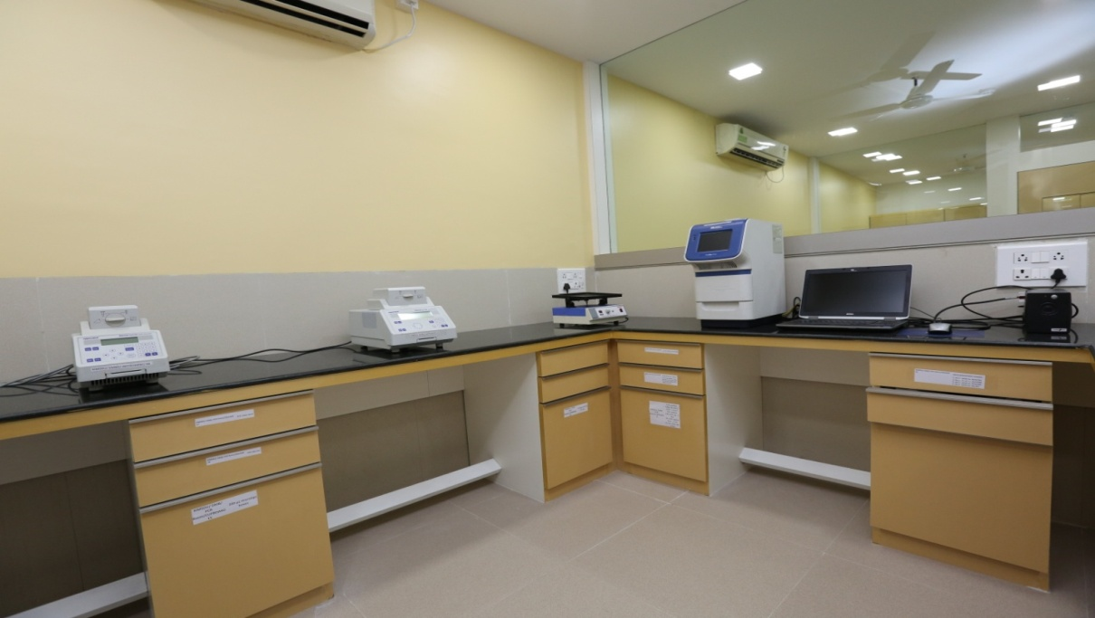
Sample Processing Room
PCR (Master Cyclers)

Slide 19
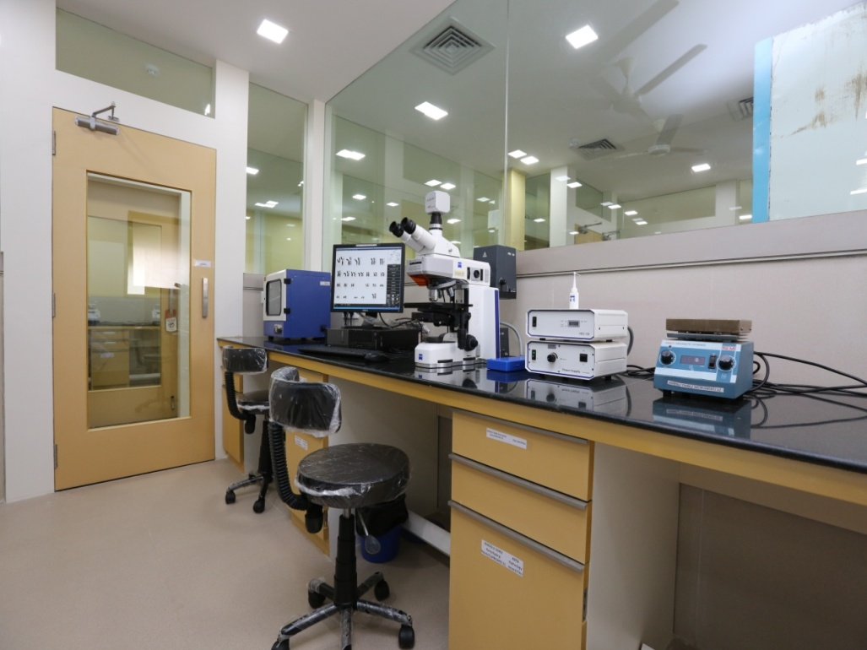
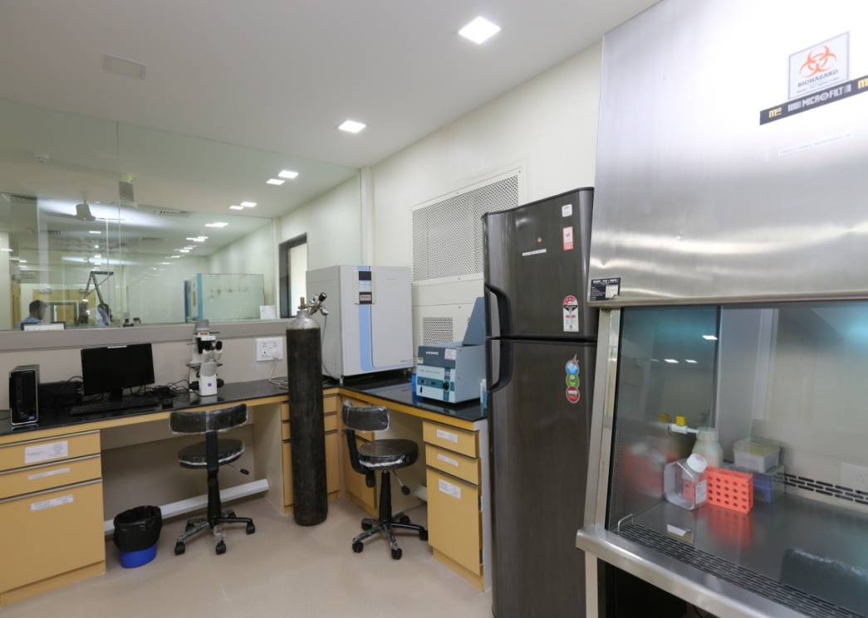
Fluroscence Microscope (Karyotyping)
Animal Tissue Culture

Slide 20
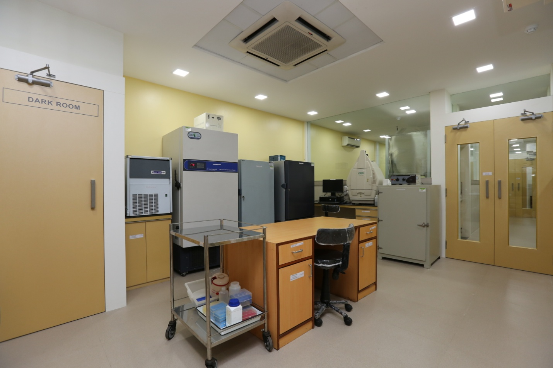
Deep Freezers

